Slide 1
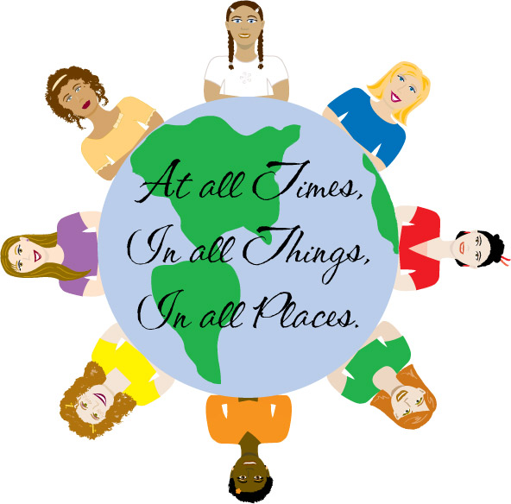
Culture

Slide 2

Culture
https://www.youtube.com/watch?v=nf1kT-x_JEE
Culture: totality of learned, socially transmitted customs, knowledge, material objects, and behaviour
Includes ideas, values, customs, and artifacts of groups of people Common culture is shared by people in a society—the largest form of human group
Common culture simplifies day-to-day interactions
Culture influences human behaviour

Slide 3
Culture
A fairly large number of people are said to constitute a society when they live in the same territory, are relatively independent of people outside their area, and participate in a common culture.
Members of a society generally share a common language, which facilitates day-to-day exchanges with others.
https://www.youtube.com/watch?v=woP0v-2nJCU

Slide 4
Characteristics of Culture
Culture is shared uniquely
Culture is learned
Cultural transmission – passing of cultural traits from one generation to the next
Culture is based on symbols

Slide 5
Characteristics of Culture
Culture is integrated
Cannot change one element without impacting another
Cultural integration – close relationship among various elements of a cultural system
Cultural lag – period of maladjustment when an element of culture changes and disrupts a system
https://www.youtube.com/watch?v=2xJ_hbD4TQA

Slide 6
Cultural universals
Cultural universal: certain common practices and beliefs that all societies have developed
Many adaptations to meet essential human needs
https://www.youtube.com/watch?v=s7EpWhB0Qk0

Slide 7
Ethnocentrism and cultural relativism
Ethnocentrism: tendency to assume that one’s own culture and way of life represents the norm or is superior to others
Our view of the world is dramatically influenced by the society in which we were raised
https://www.youtube.com/watch?v=zSJFBeVFtak
Cultural relativism: people’s behaviors from the perspective of their own culture
Different social contexts give rise to different norms and values

Slide 8
Xenocentrism
Xenocentrism is the belief that the products, styles, or ideas of one’s society are inferior to those that originate elsewhere. In a sense, it is a reverse ethnocentrism. [Häagen Dazs ice cream, made in New Jersey, USA, is an example to make it sounded European]

Slide 9
Bilingualism
Bilingualism refers to the use of two or more languages in a particular setting, such as the workplace or educational facilities, treating each language as equally legitimate. Thus, a program of bilingual education may instruct children in their native language while gradually introducing them to the language of the host society.
For a long time people in the United States demanded conformity to a single language. In a sense, this demand coincides with the functionalist view that language serves to unify members of a society.
Beginning in the 1960s, active movements for Black pride and ethnic pride insisted that people regard the traditions of all racial and ethnic subcultures as legitimate and important. Conflict theorists explain this development as a case of subordinated language minorities seeking opportunities of self-expression. The perspective of conflict theory also helps us understand some of the attacks on bilingual programs. Many of them stem from an ethnocentric point of view, which holds that any deviation from the majority is bad.

Slide 10
Socio-biology and Culture
Socio-biology: systematic study of how biology affects human social behavior
Founded on Darwin’s theory of evolution
Most social scientists would agree there is a biological basis for social behavior

Slide 11
Aspects of cultural variation: Subculture
A subculture is a segment of society that shares a distinctive pattern of mores, folkways, and values that differ from the patterns of the larger society.
The existence of many subcultures is characteristic of complex societies such as the United States.
Members of a subculture participate in the dominant culture, while at the same time engaging in their unique and distinctive forms of behavior.
Frequently, a subculture will develop an argot, or specialized language, which distinguishes it from the wider society.

Slide 12
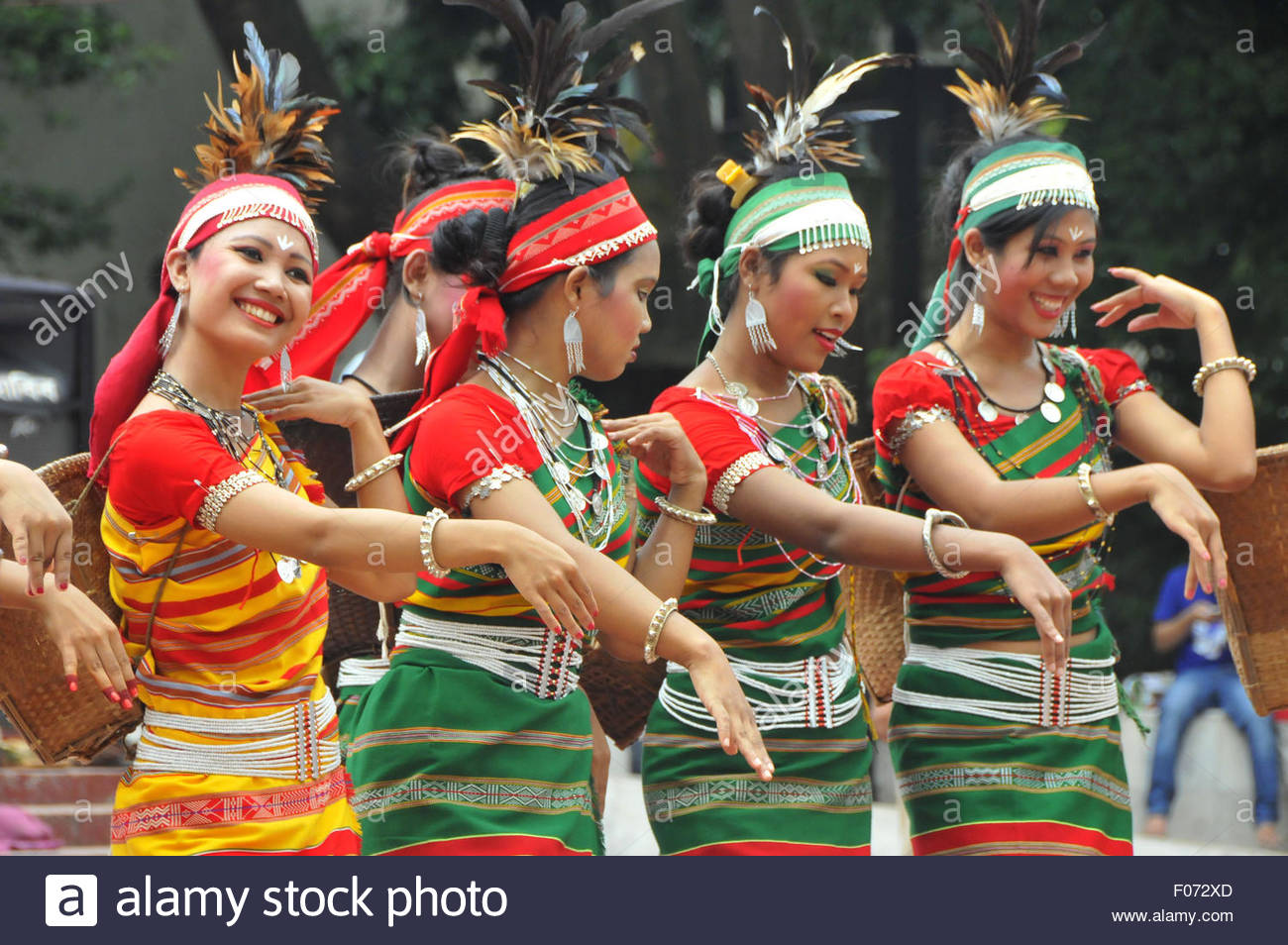
Subculture and Counter Culture
Subcultures may be based on common age (teenagers or old people), region, ethnic heritage (Garo, Khasia), occupation (fire-fighters), beliefs (deaf activists working to preserve deaf culture), or shared interest or hobby (computer hackers).

Slide 13

Counter Culture
When a subculture conspicuously and deliberately opposes certain aspects of the larger culture, it is known as a Countercultures typically thrive among the young, who have the least investment in the existing culture. In most cases, a 20-year-old can adjust to new cultural standards more easily than someone who has spent 60 years following the patterns of the dominant culture.

Slide 14
Cultural Shock
Anyone who feels disoriented, out of place, even fearful, when immersed in an unfamiliar culture may be experiencing culture shock. All of us, to some extent, take for granted the cultural practices of our society. As a result, it can be surprising and even disturbing to realize that other cultures do not follow our ‘way of life.’ [e.g., US people see dog meat eaters in China; a strict Islamic woman is shocked by provocative dress on a US teen.

Slide 15
Elements of Culture: Language
Language is an abstract system of word meanings and symbols for all aspects of culture.
It includes speech, written characters, numerals, symbols, and gestures and expressions of nonverbal communication.
Unlike some other elements of culture, language permeates all parts of society.
While language is a cultural universal, striking differences in the use of language are around the world.

Slide 16
Language: Written and Spoken
Sapir-Whorf Hypothesis
Language precedes thought
Language is not a given
Language is culturally determined
Language may color how we see the world

Slide 17
Nonverbal Communication
Nonverbal communication: use of gestures, facial expressions, and other visual images to communicate
Learned
Differs by culture
Symbols: gestures, objects, and words that form basis of human communication
https://www.youtube.com/watch?v=qCo3wSGYRbQ

Slide 18
Norms and Sanction
All societies have ways to encourage and enforce appropriate behavior, and discourage and punish inappropriate behaviour
Collective idea of what is good and desirable, and what is not

Slide 19
Norms
Norms: established standards of behavior maintained by a society
To be significant, must be widely shared and understood
Persistent social norm in contemporary society: heterosexuality

Slide 20
Norms
Types of Norms
Formal norms: generally written; specify strict punishments
Law: governmental social control
Informal norms: generally understood but not precisely recorded
Mores: norms deemed highly necessary to the welfare of a society
Folkways: norms governing everyday behavior

Slide 21
Sanctions
Sanctions: penalties and rewards for conduct concerning social norm
Positive sanctions: pay raises, medals, words of gratitude
Negative sanctions: fines, threats, imprisonment, and stares of contempt

Slide 22
Acceptance of Norms
People do not follow norms in all situations
Behavior that appears to violate society’s norms may represent adherence to a particular group’s norms
Norms may be violated because they conflict with other norms
Acceptance of norms is subject to change
Sudden change can upset an entire population

Slide 23
Values
Cultural values: collective conceptions of what is good, desirable, and proper— or bad, undesirable, and improper
Influence people’s behaviour
Criteria for evaluating actions of others
Values may change, but most remain relatively stable during any one person’s lifetime

Slide 24
Sociological Perspectives on Culture
Functionalists maintain that social stability requires a consensus and the support of society’s members; strong central values and common norms provide that support
Conflict theorists argue that common culture serves to maintain the privileges of certain groups

Slide 25
Sociological Perspectives on Culture
Dominant ideology: set of cultural beliefs and practices that help maintain powerful interests
Social interests
Economic interests
Political interests
Conflict perspective: dominant ideology has major social significance

Slide 26
Development of Culture around the World
Despite their differences, all societies have developed certain common practices and beliefs known as cultural universals.
Anthropologist George Murdock compiled a list of cultural universals, including athletic sports, marriage, cooking, funeral ceremonies, medicine, and sexual restrictions.
The cultural practices listed by Murdock may be universal, but the manner in which they are expressed varies from culture to culture.

Slide 27
Development of Culture around the World
Innovation: process of introducing a new idea or object to a culture
Discovery: making known or sharing existence of an aspect of reality
Invention: existing cultural items combined into form that did not exist before

Slide 28
Globalization, Diffusion, and Technology
Diffusion: process by which cultural item spreads from group to group
McDonaldization of society: process through which principles of fast-food industry dominate certain sectors of society
Technology: information about how to use material resources of the environment to satisfy human needs and desires (Nolan and Lenski)

Slide 29
Globalization, Diffusion, and Technology
Material culture: physical or technological aspects of daily lives
Nonmaterial culture: ways of using material objects
Culture lag: period of maladjustment when nonmaterial culture struggles to adapt to new material conditions

Slide 30
Cultural Change
If Cultures goes through these different phases , then they have to change
As cultures change, they strive to maintain cultural integration, the close relationship among various elements of a cultural system. - William Ogburn’s concept of cultural lag refers to the fact that cultural elements change at different rates, which may disrupt a cultural system. –
Three phenomena promote cultural change
Inventions, the process of creating new cultural elements.
Discovery, recognizing and understanding an idea not fully understood before.
Diffusion, the spread of cultural traits from one cultural system to another

